Slide 1
U10 Soccer

Slide 2
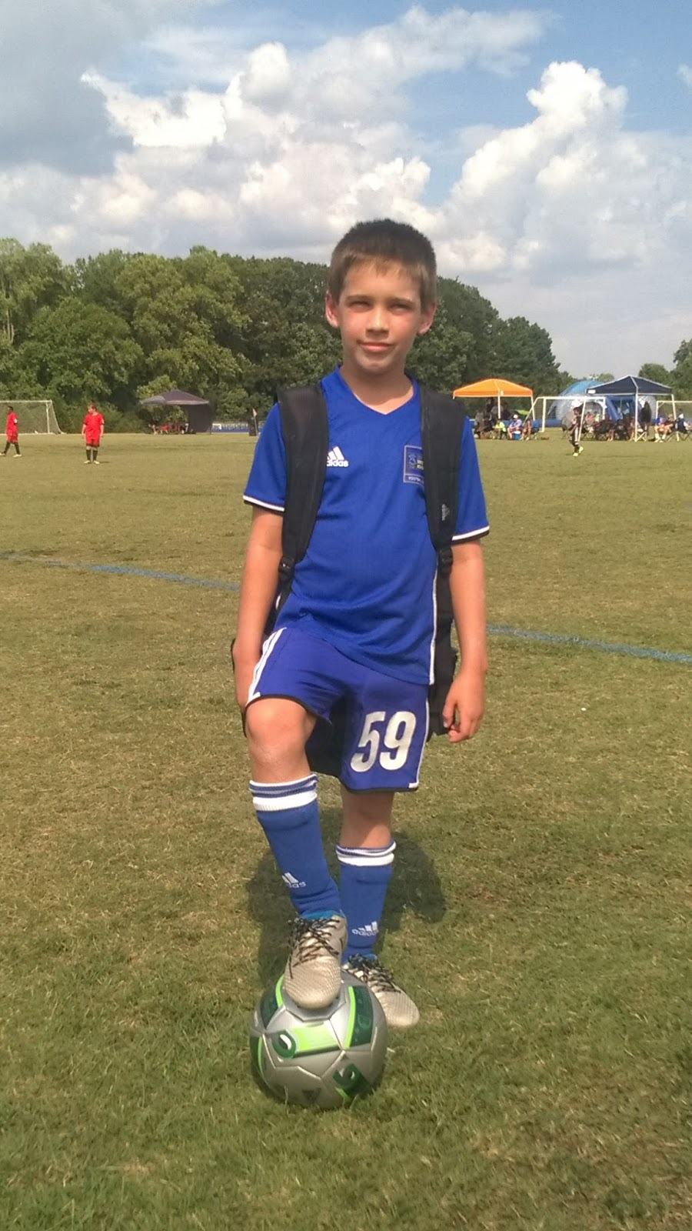
The Basics
Single gender
Players born in 2015 & 2014 (does not matter when the birthday)
#4 ball used (always require player to bring a ball with them to practice)
Additional steps to playing “real soccer”

Slide 3
U10 Soccer--Training
Training- 1 or 2 times per week, 60-75 minutes
After matches start—up to coach, but no more than once per week
Training should be fun but focus on needs of the team
Combination individual activities & working together as a team
Begin to work together
Create environment that will challenge but not discourage—small successes matter.
End every training session with a scrimmage (regardless of numbers at practice)
Remember may have combination of new and returning players
Soccer Coach Weekly - U10 Football Drills

Slide 4
U10 Soccer--Matches
7 v 7
Kick Off (not to the other team)
Beginning of each half starts with a kick-off from center of the field (teams switch who takes)
Kick-off to begin play after goal.
Score is kept and reported, top 2 teams will receive medals (no participation medals at this age)
Goalkeeper used
Full ref crew (if available) otherwise single ref
ARs are typically young and first time refs
Respect to all refs essential
Parents NOT allowed on the field, must be on spectator sideline, may not be on team sideline, or behind goal
Coaches are expected to help insure this

Slide 5
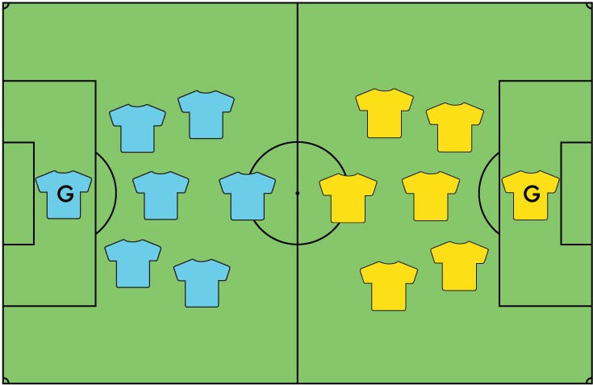

Slide 6
The Field & Buildout Line

Slide 7
Matches
All players must play 50% of the match
Substitutions at quarter break/halftime
Four 12 minute quarters
Throw-ins when ball goes out of play, corner kicks used, goal kicks used (no punting the ball)
No heading
Free kicks used w/ defenders 8 feet from ball
Penalty kicks used
Offsides!

Slide 11
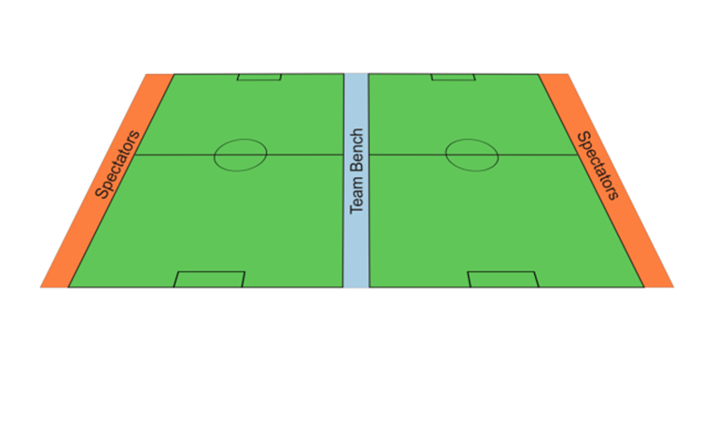
Coaches During Matches
Coaches must remain on team sideline and not cross center line
Coaches may not be on the field during play
Coaches may not be behind goal during play
Be respectful to ref, other players, parents, etc.
You are the role model of behavior
Yellow/Red card may be shown to coaches
Ejected coach must leave field and miss next match

Slide 12
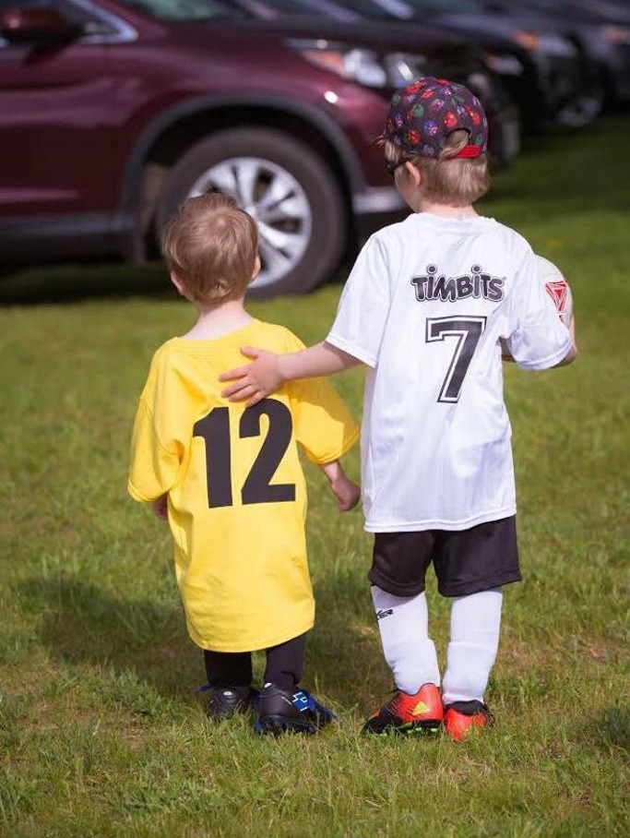
Remember…..
There is no scholarships being offered
Have fun!
Further information, resources, schedule
https://columbusmssoccer.org/recreational-soccer/

Slide 13
My Information
Dr. Thomas G. Velek
tvelek@yahoo.com
662-386-7392
FB: https://www.facebook.com/tvelek
Instagram: https://www.instagram.com/thevelek/ (@thevelek)

