Slide 1
U12/U14 Soccer

Slide 2
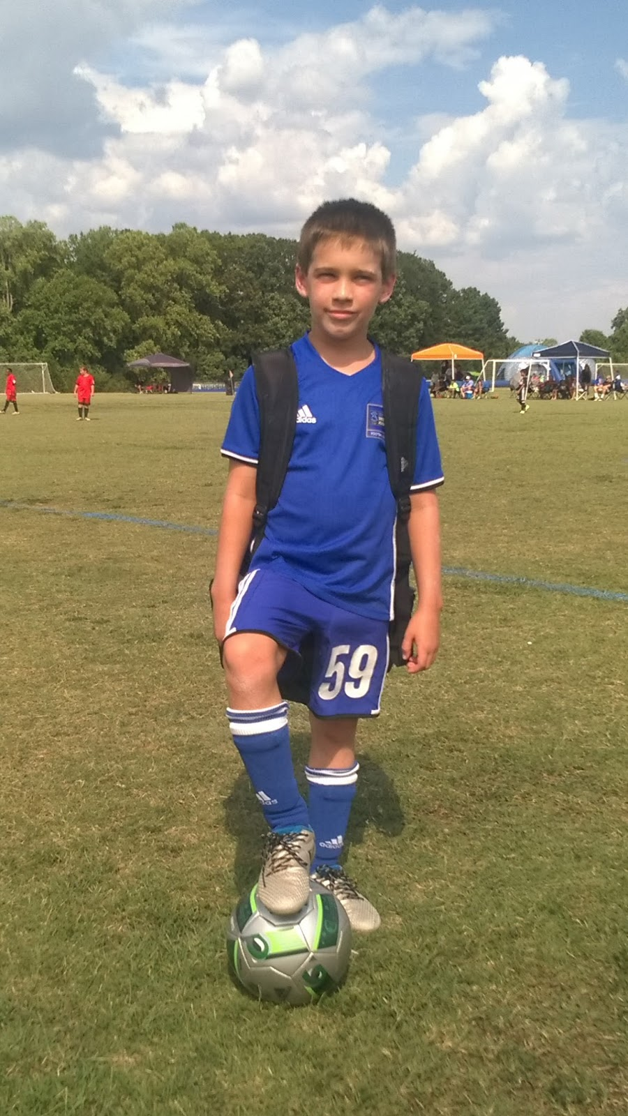
The Basics
Single gender
U12: Players ages 10 & 11 during the playing year
U14+: Players 12 years of age and older during the playing year
  does not matter when the birthday
U12: #4 ball used
U14+: #5 ball used
  always require player to bring a ball with them to practice
“real soccer”

Slide 3
Training
Training- 1 or 2 times per week, 75-90 minutes
  After matches start—up to coach, but no more than once per week
Training should be fun but focus on needs of the team
  Combination individual activities & working together as a team
  Focus on working together
  Create environment that will challenge but not discourage—small successes matter.
  End every training session with a scrimmage (regardless of numbers at practice)
  Remember may have combination of new and returning players (but mostly returning)
  Soccer Coach Weekly - U12
  Under 14 Soccer Drills, Games, and Exercises (soccerxpert.com)

Slide 4
Matches
U12: 9 v9
U14+: 9 v 9 (modified rec rule)
Score is kept and reported, top 2 teams will receive medals (no participation medals at this age)
Full ref crew (if available) otherwise single ref
  ARs are typically young and first time refs
  Respect to all refs essential
Parents NOT allowed on the field, must be on spectator sideline, may not be on team sideline, or behind goal
  Coaches are expected to help insure this

Slide 5
Matches
All players must play 50% of the match
Substitutions at quarter break/halftime
  U12: Four 15 minute quarters
  U14+: Four 17 ½ minute quarters
Almost all rules are FIFA—throw-in, offsides, free kicks, corner kicks, penalty kicks, etc.
Heading?—allowed at u14, waiting on ruling at u12 due to dual age group.
Offsides???—Refresher???

Slide 6



Slide 9
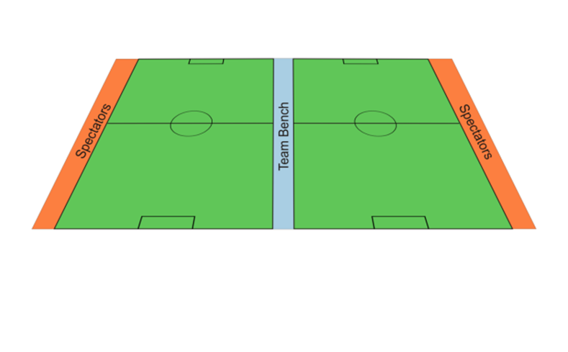
Coaches During Matches
Coaches must remain on team sideline and not cross center line
Coaches may not be on the field during play
Coaches may not be behind goal during play
Be respectful to ref, other players, parents, etc.
  You are the role model of behavior
Yellow/Red card may be shown to coaches
  Ejected coach must leave field and miss next match

Slide 10
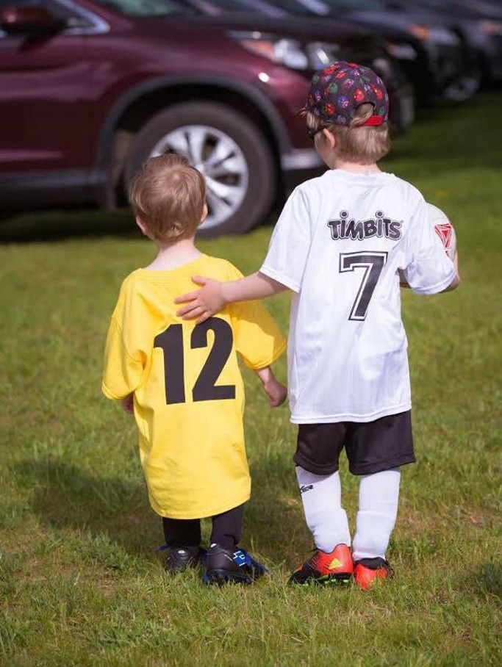
Remember…..
There is no scholarships being offered
Have fun!
Further information, resources, schedule
https://columbusmssoccer.org/recreational-soccer/

Slide 11
My Information
Dr. Thomas G. Velek
tvelek@yahoo.com
662-386-7392
FB: https://www.facebook.com/tvelek
Instagram: https://www.instagram.com/thevelek/ (@thevelek)

