Slide 1
U6 Soccer

Slide 2
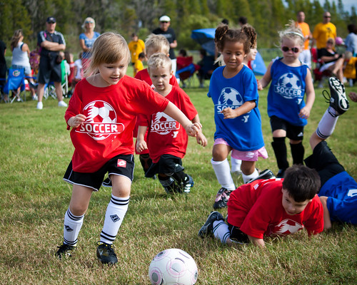
U6 Soccer—The Basics
Co-ed or single gender depending on numbers
Players age 4 & 5 at any time during year of play (does not matter when the birthday)
#3 ball used (always require player to bring a ball with them to practice)

Slide 3
U6 Soccer--Training
Training- 1 or 2 times per week, 45-60 minutes
After matches start—up to coach, but no more than once per week
Training should focus on fun games that help players get comfortable with the ball.
Primarily individual activities
Don’t expect to share, pass
Create environment that will challenge but not discourage—small successes matter.
https://www.soccercoachweekly.net/age-groups/u5/

Slide 4
U6 Soccer--Matches
4 v 4
Kick Off (not to the other team)
Beginning of each half starts with a kick-off from center of the field (teams switch who takes)
Kick-off to begin play after goal.
Score is not kept nor recorded
No goalies
No referees
One parent from each team is on the field (other parents on supporter sideline)
One keeps time
One acts as “ref”
No “fouls”—ie no free kicks or penalty kick

Slide 6
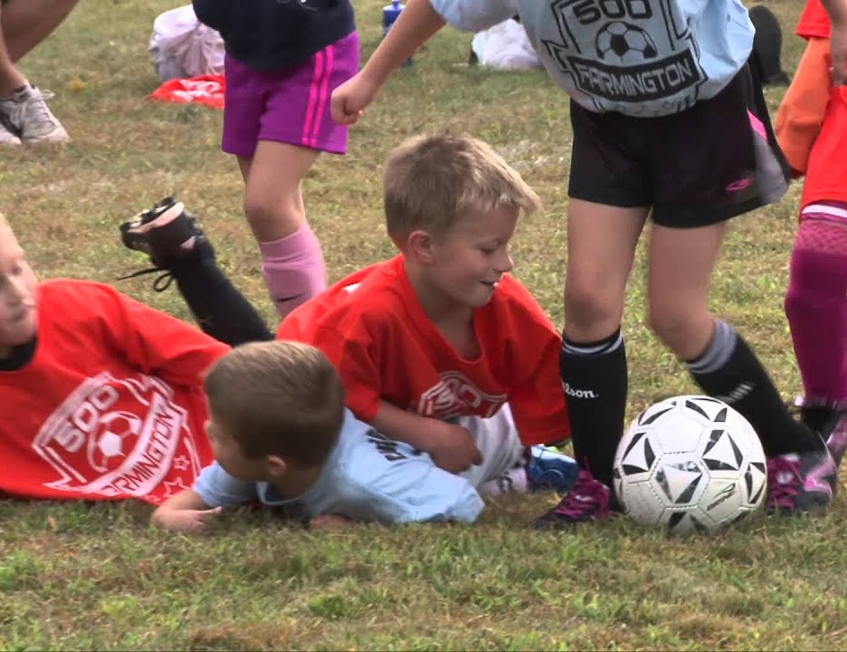
U6 Soccer -Matches
All players must play 50% of the match
Substitutions at quarter break/halftime
Four 8 minute quarters
Kick-ins to restart play when ball goes out
No heading, no throw-ins

Slide 7
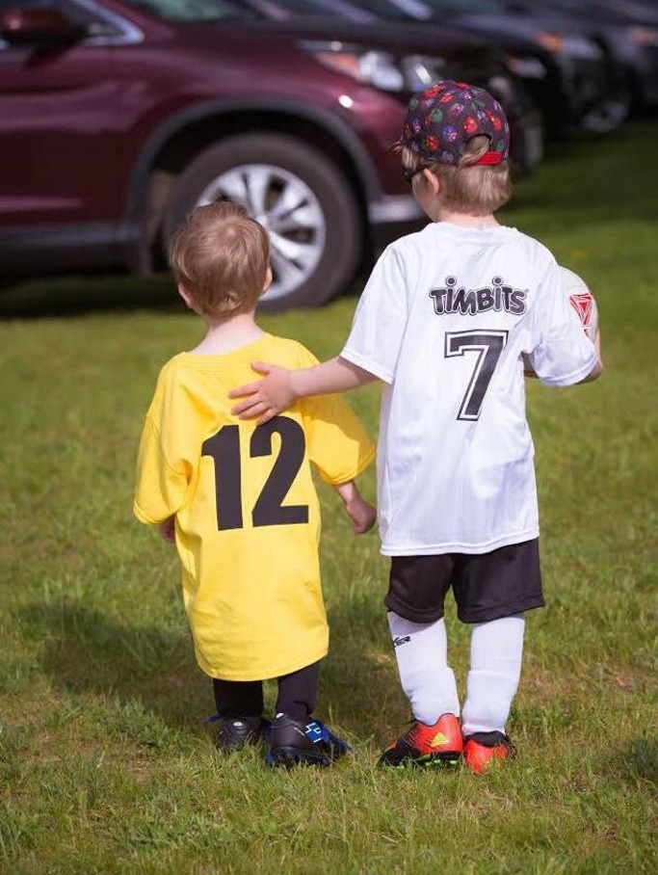
Remember…..
There is no scholarships being offered
Have fun!
Further information, resources, schedule
https://columbusmssoccer.org/recreational-soccer/

Slide 8
My Information
Dr. Thomas G. Velek
tvelek@yahoo.com
662-386-7392
FB: https://www.facebook.com/tvelek
Instagram: https://www.instagram.com/thevelek/ (@thevelek)

