Slide 1
U8 Soccer

Slide 2
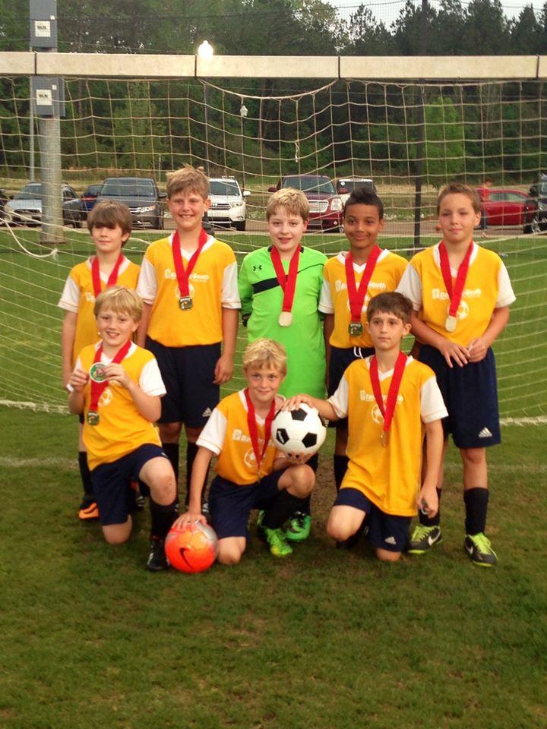
The Basics
Single gender
Players ages 6 & 7 in the playing year (does not matter when the birthday)
#3 ball used (always require player to bring a ball with them to practice)
First step to playing “real soccer”

Slide 3
U8 Soccer--Training
Training- 1 or 2 times per week, 45-60 minutes
After matches start—up to coach, but no more than once per week
Training should focus on fun games that help players get comfortable with the ball.
Primarily individual activities
Begin to work together
Create environment that will challenge but not discourage—small successes matter.
Soccer Coach Weekly - U7

Slide 4
U8 Soccer--Matches
5 v 5
Kick Off (not to the other team)
Beginning of each half starts with a kick-off from center of the field (teams switch who takes)
Kick-off to begin play after goal.
Score is kept and reported
Goalkeeper ARE NOT used at U8. May have a player in the goal area but can not use hands, etc.
Single referee (typically young and first time as center ref)
Parents NOT allowed on the field, must be on spectator sideline, may not be on team sideline, and may not be behind goal
Coaches are expected to help insure this

Slide 5
The Field

Slide 7
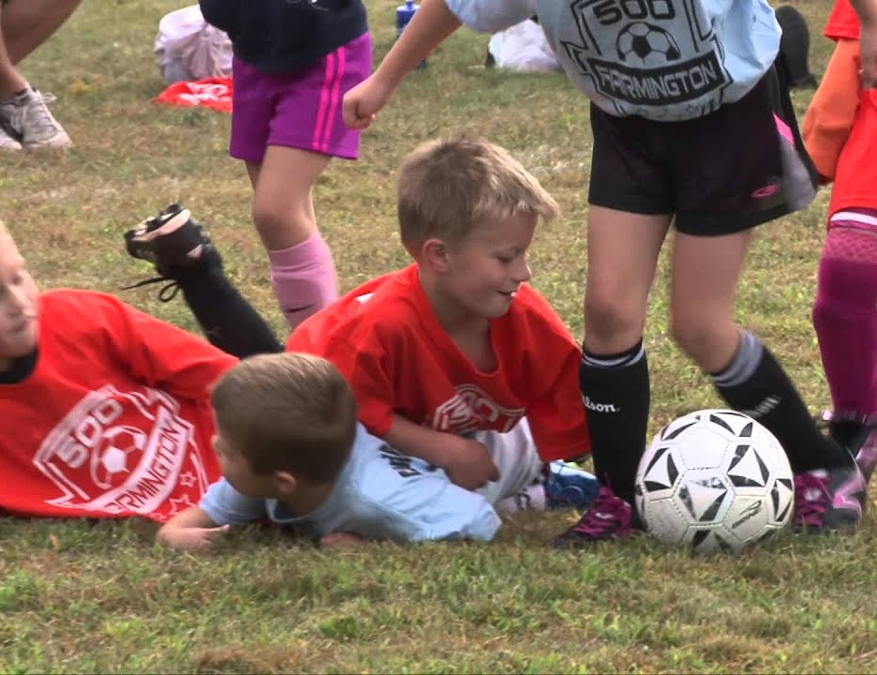
Matches
All players must play 50% of the match
Substitutions at quarter break/halftime ONLY
Four 10 minute quarters
Throw-ins when ball goes out of play
No heading, no off-sides
All free kicks are indirect—w/ defenders 5 feet from ball
No penalty kicks

Slide 8
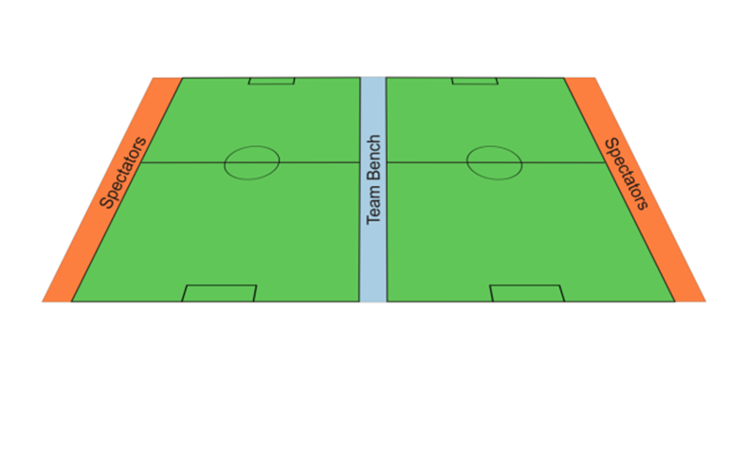
Coaches During Matches
Coaches must remain on team sideline and not cross center line
Coaches may not be on the field during play
Coaches may not be behind goal during play
Be respectful to ref, other players, parents, etc.
You are the role model of behavior
Yellow/Red card may be shown to coaches
Ejected coach must leave field and miss next match

Slide 9
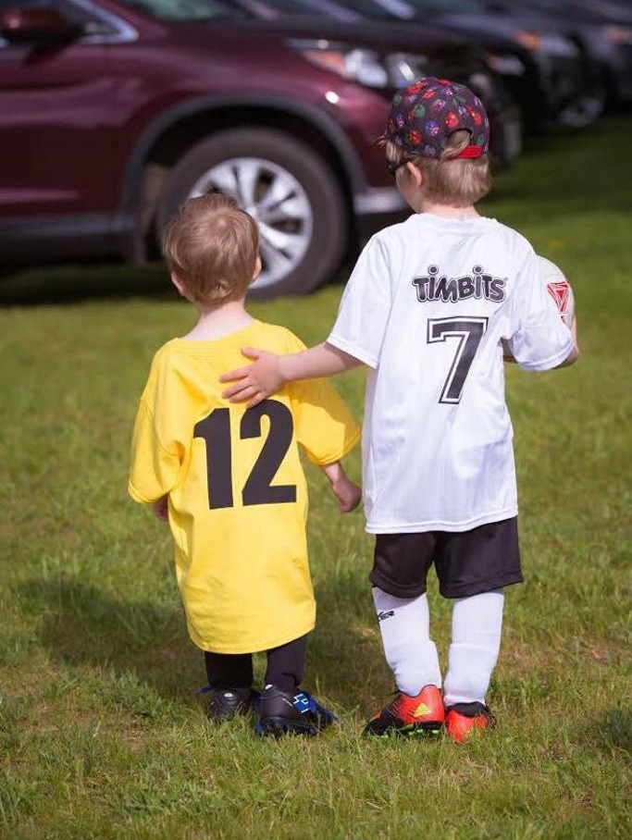
Remember…..
There is no scholarships being offered
Have fun!
Further information, resources, schedule
https://columbusmssoccer.org/recreational-soccer/

Slide 10
My Information
Dr. Thomas G. Velek
tvelek@yahoo.com
662-386-7392
FB: https://www.facebook.com/tvelek
Instagram: https://www.instagram.com/thevelek/ (@thevelek)

